Slide 1
Edit Hair with image and text
Sinh viên: Lê Hồng Quân

Slide 2
Table of contents
01
02
03
04
05
06
Problem Statement
Background
Method
Experiment
Further Experiment
Evaluation

Slide 3
01
Problem Statement

Slide 4
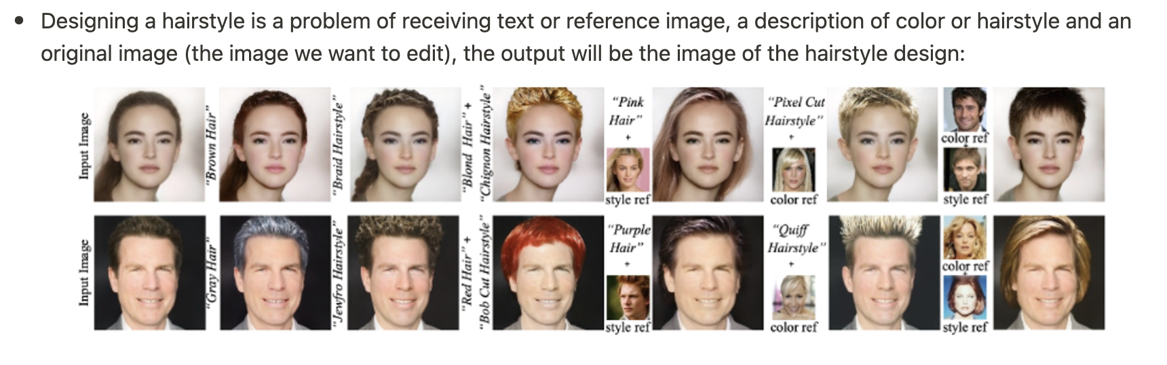
Problem

Slide 5
02
Background

Slide 6
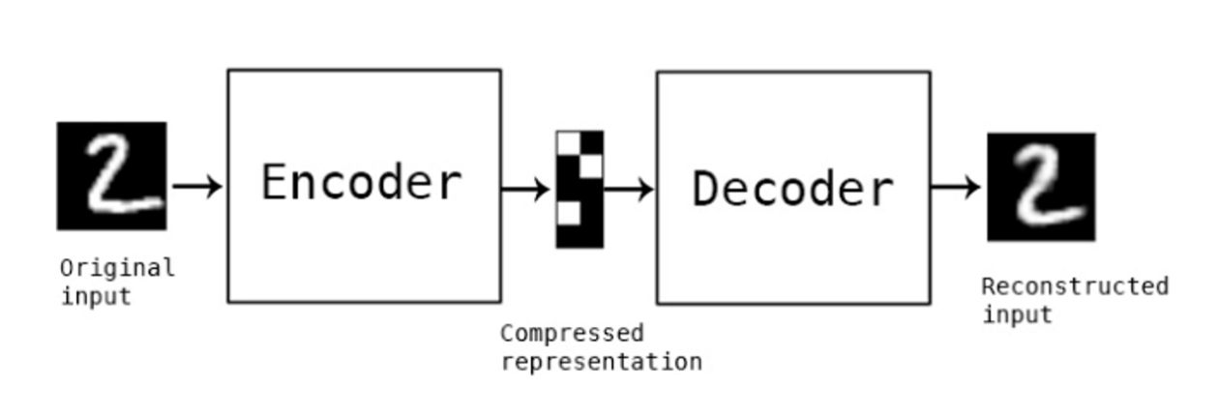
Auto-Encoder

Slide 7
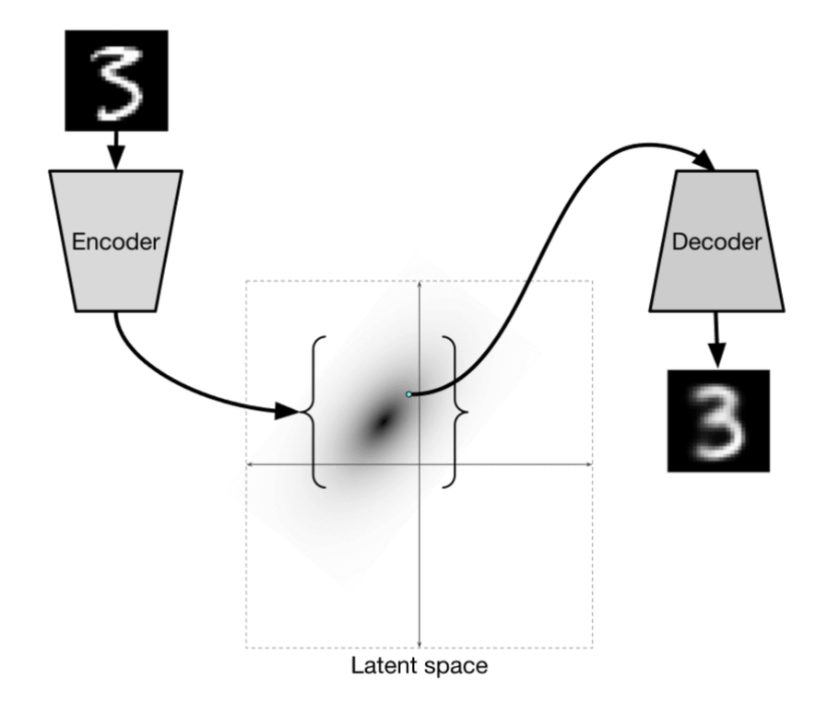
VAE

Slide 8
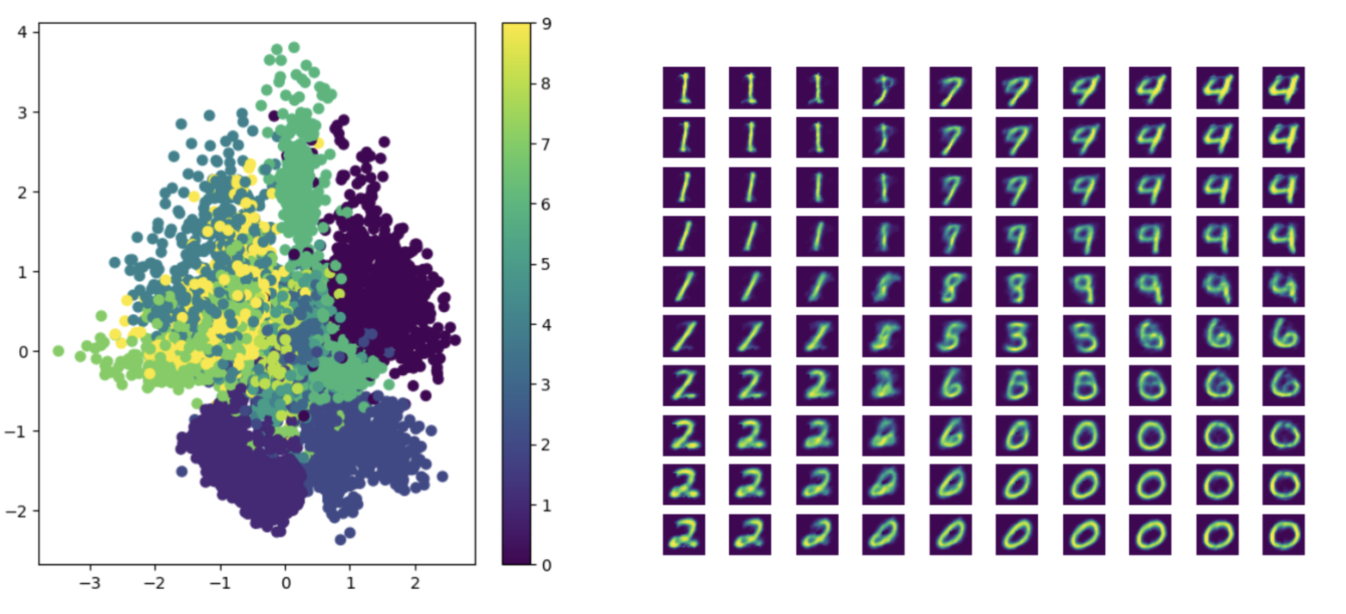
VAE

Slide 9
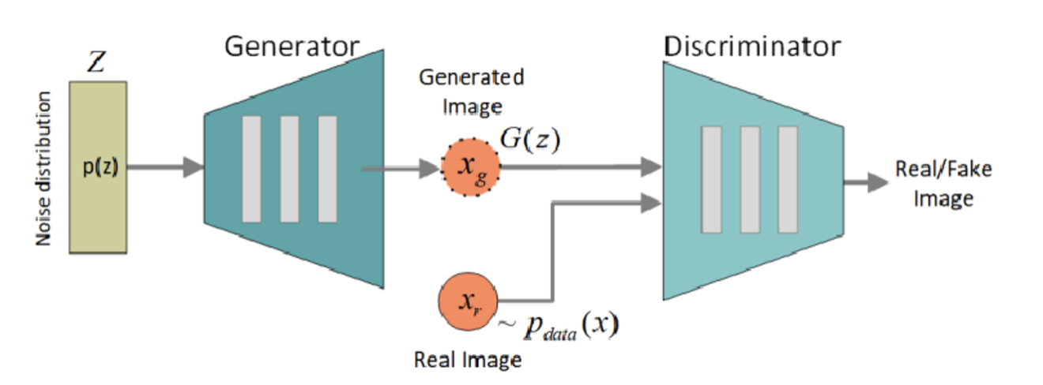
GAN

Slide 10
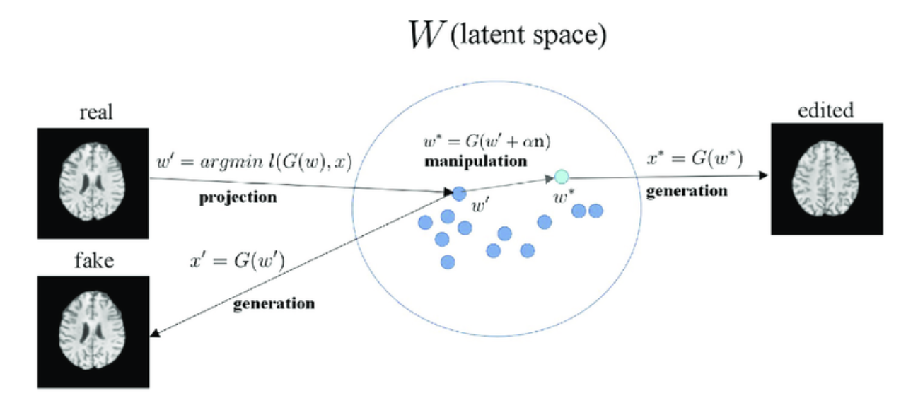
Latent-Space Manipulation

Slide 11
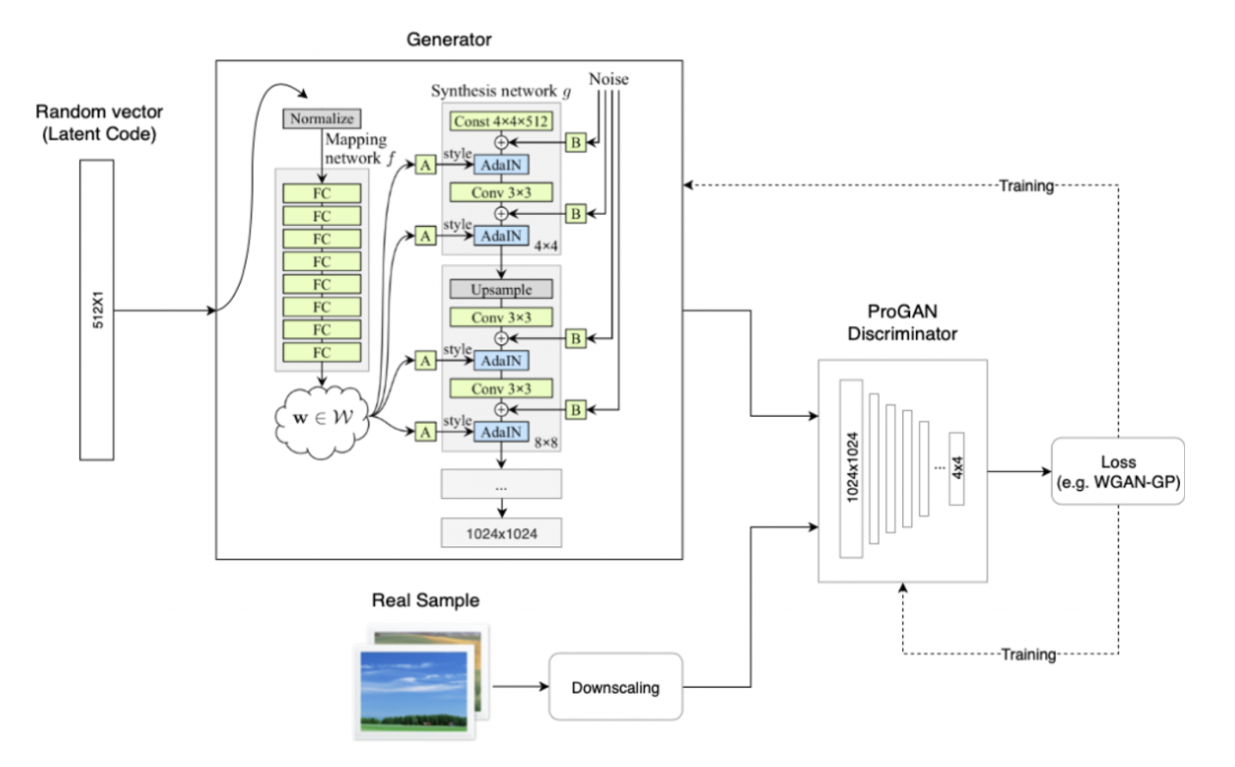
StyleGAN

Slide 12
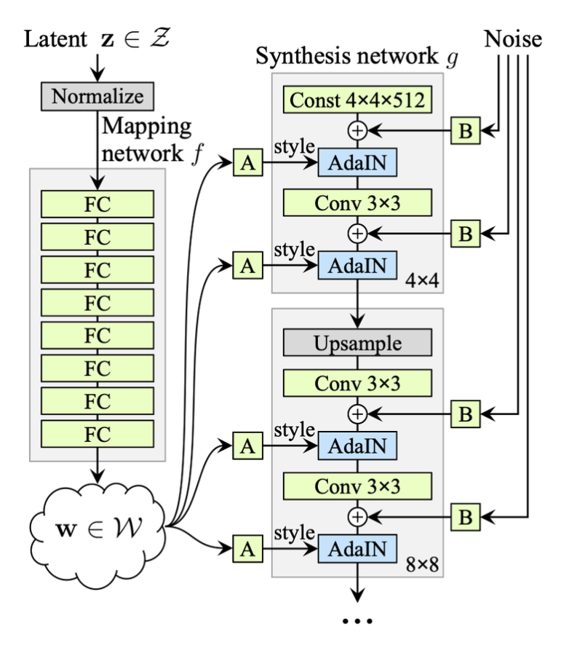
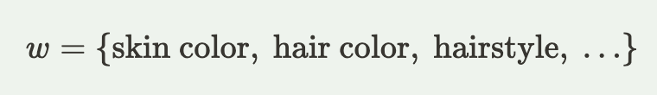
Mapping Network

Slide 13
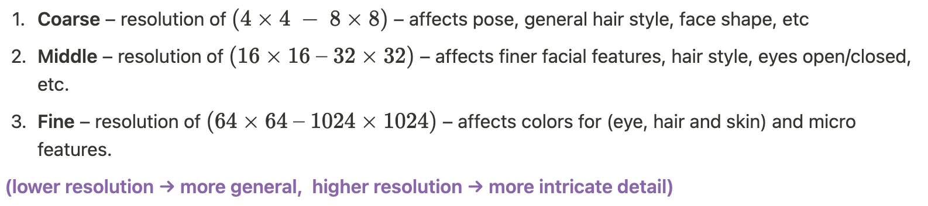
Synthesis Network

Slide 14
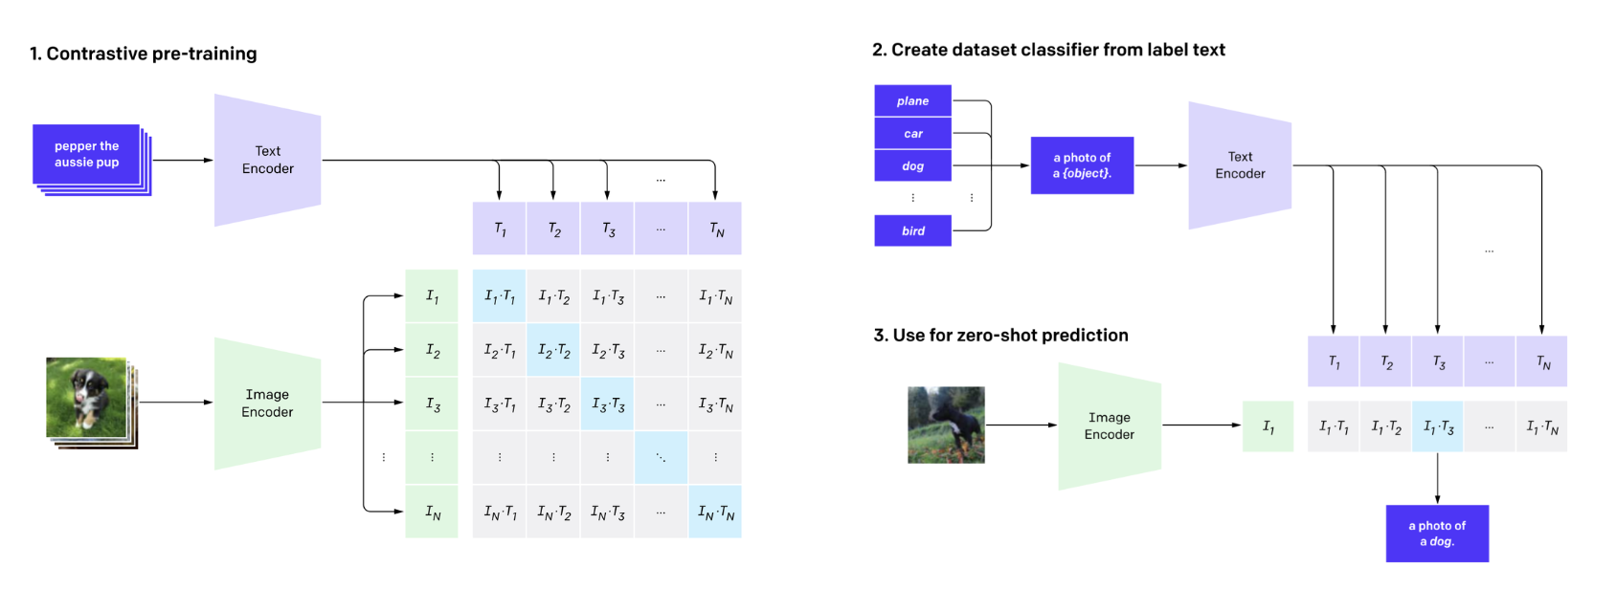
CLIP

Slide 15
03
Method

Slide 16
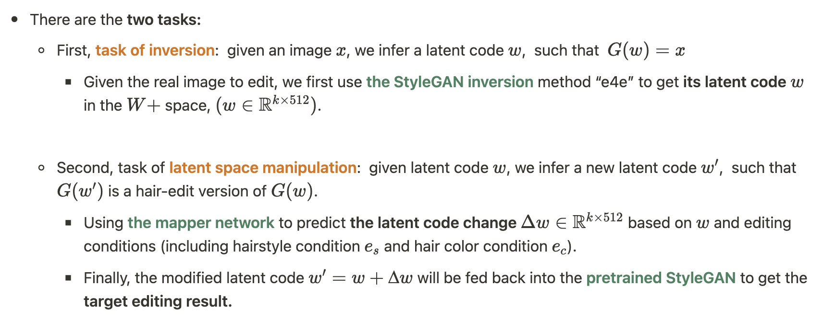
Task

Slide 17
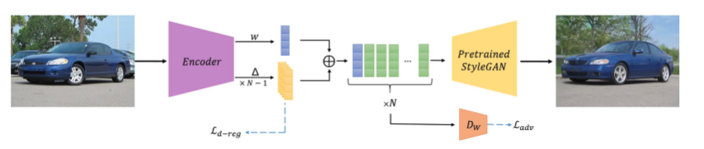
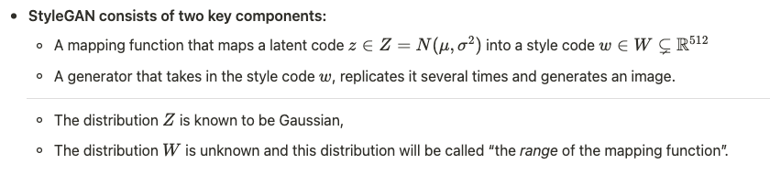
E4e encoder

Slide 18
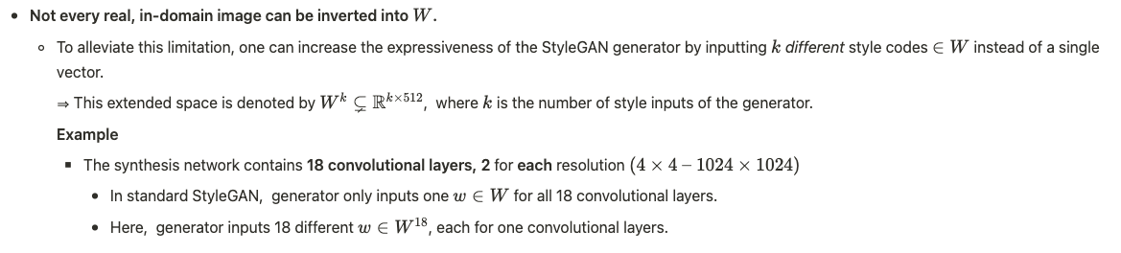
E4e encoder

Slide 19
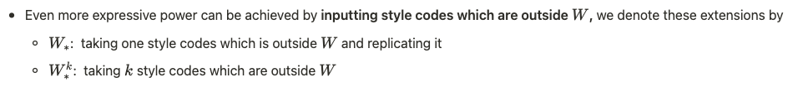
E4e encoder

Slide 20
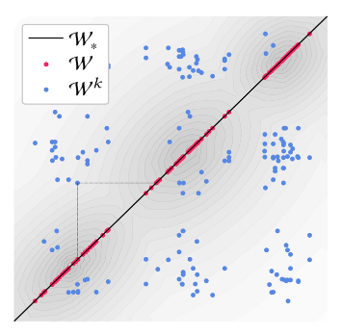
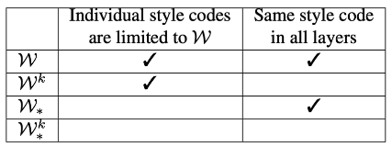
E4e encoder

Slide 21
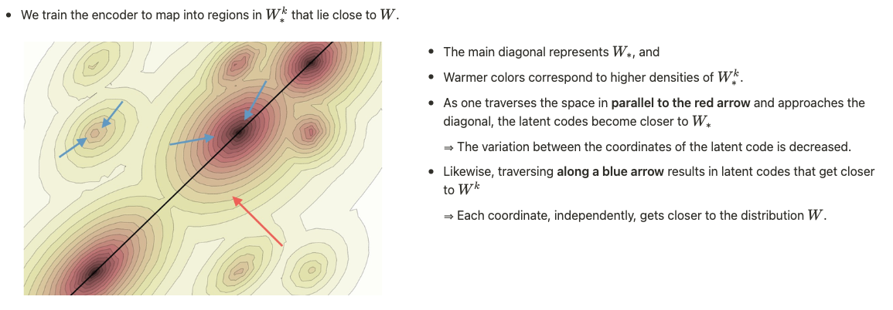
E4e encoder

Slide 22
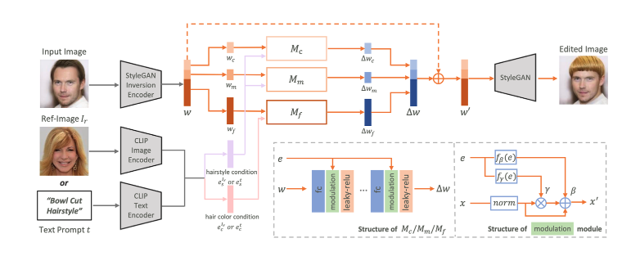
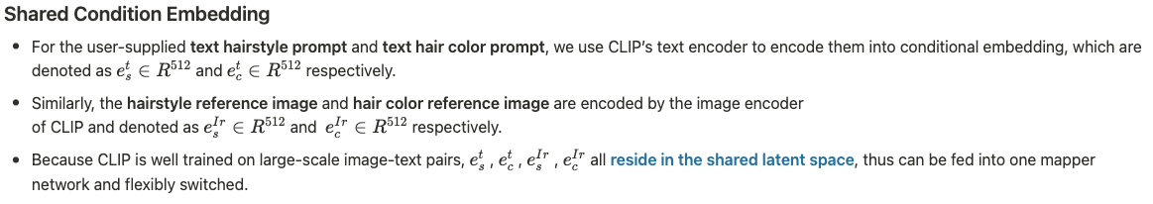
HairClip

Slide 23
HairClip

Slide 24
HairClip

Slide 25
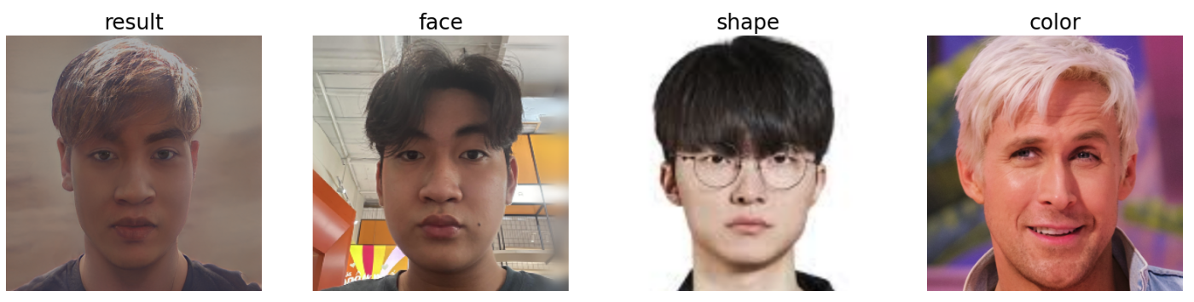
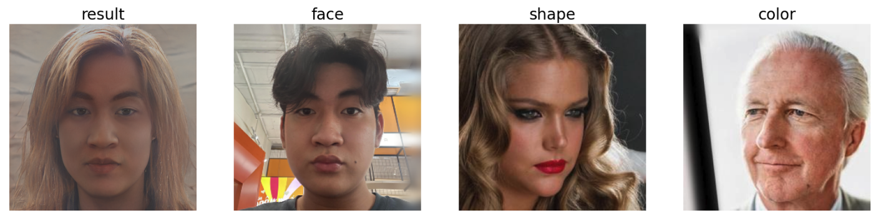
E4e-demo

Slide 26
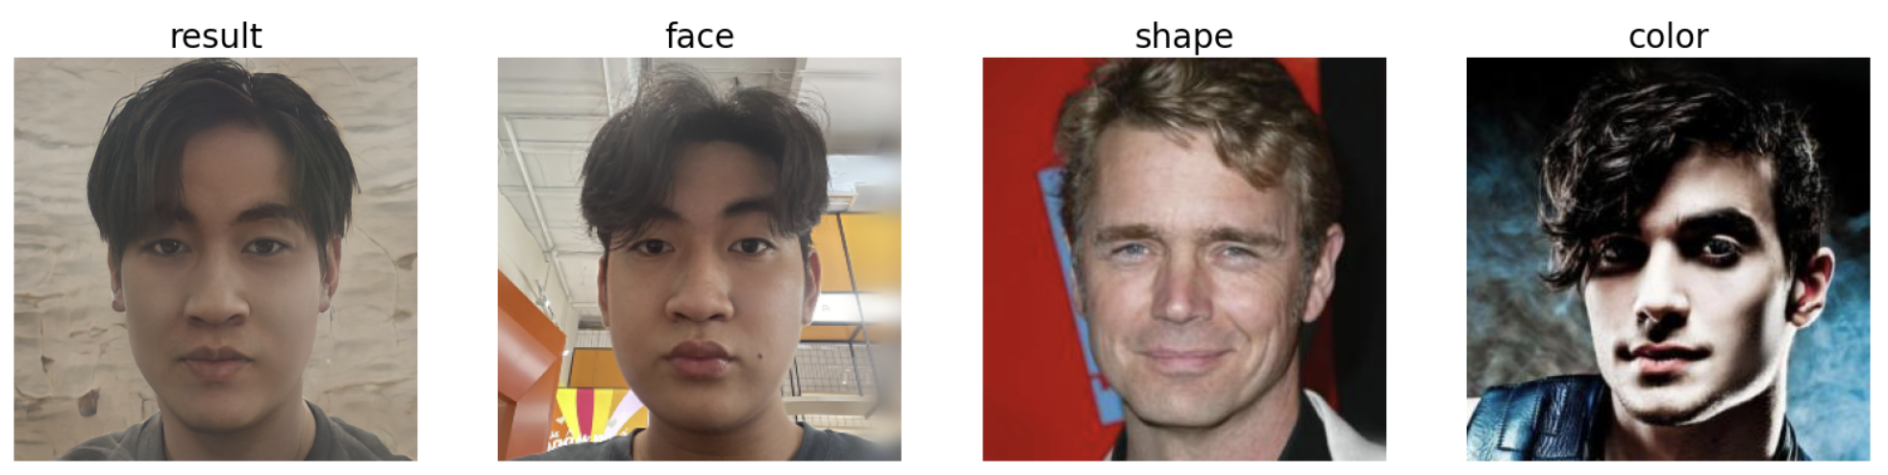
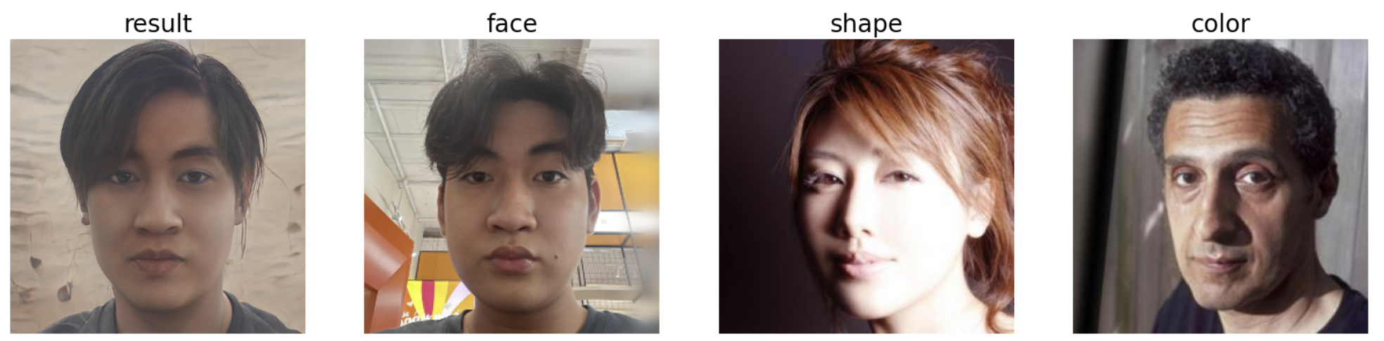
E4e-demo

Slide 27
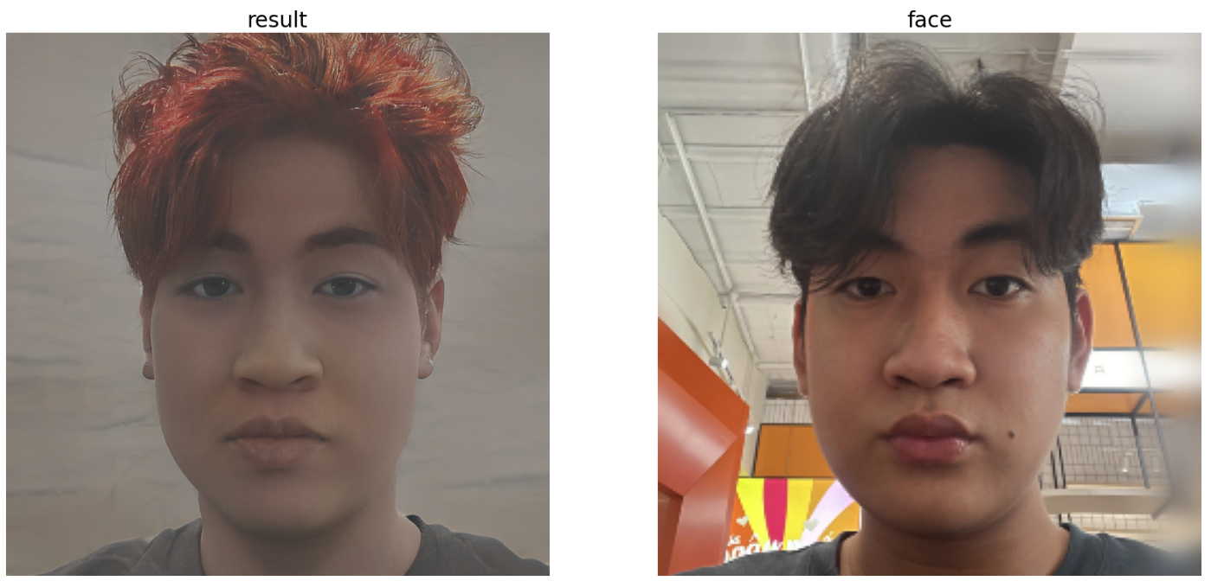
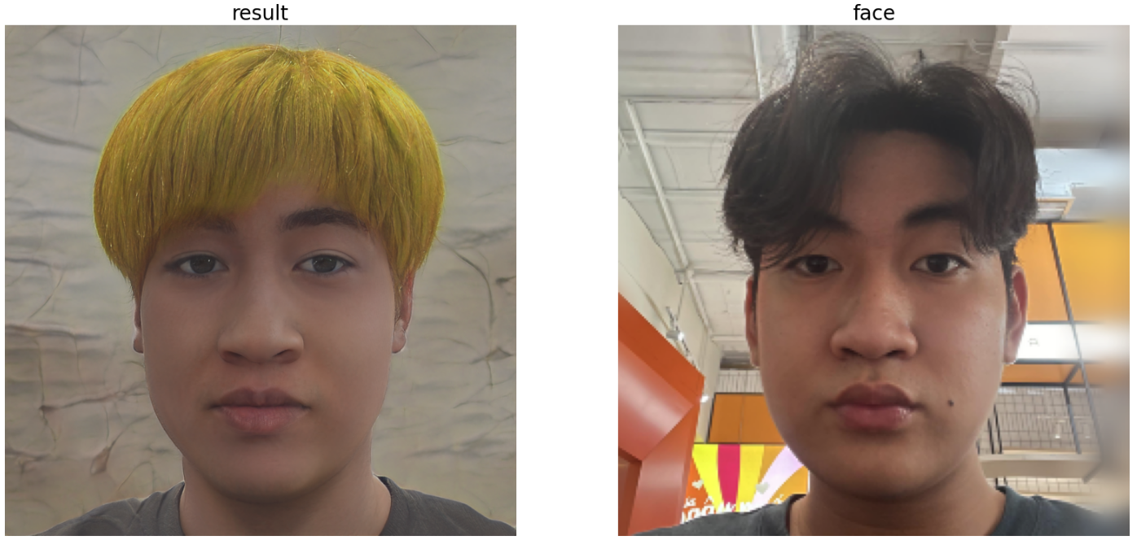
E4e-demo
curtained hair hairstyle
red
shingle bob hairstyle
yellow

Slide 28
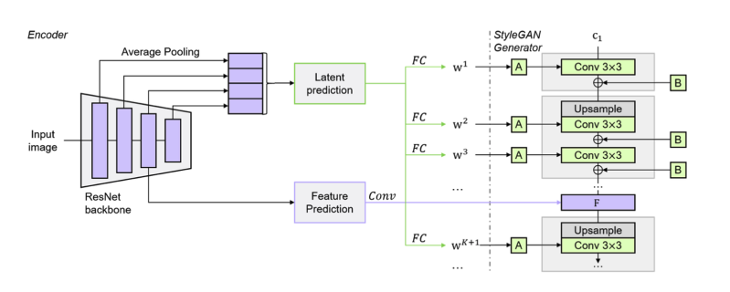
FS-encoder

Slide 29
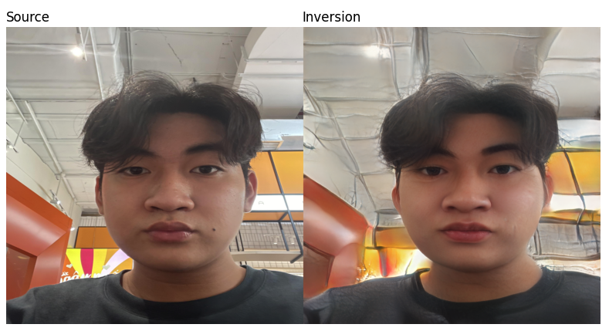
FS-inversion

Slide 30
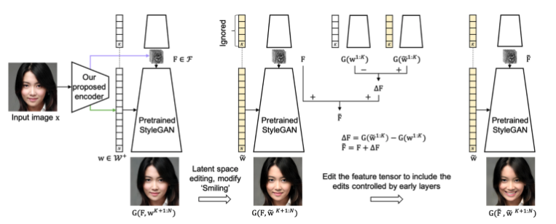
FS-edit

Slide 31
04
Experiment

Slide 32
Modification
FS encoder

Slide 33
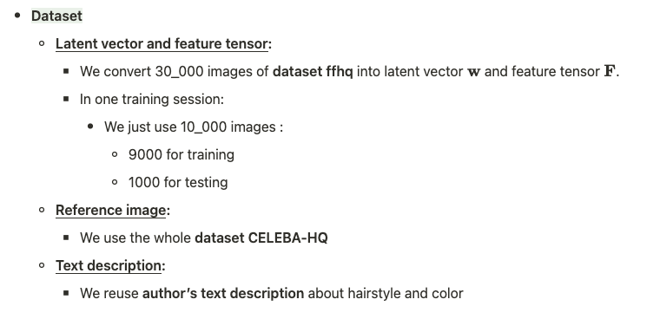
Fine tuning

Slide 34
Fine tuning

Slide 35
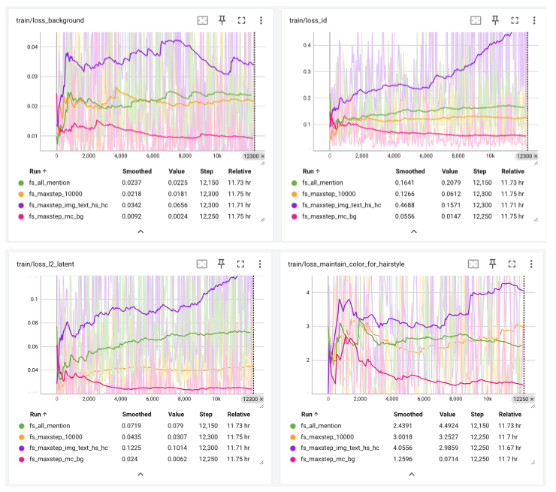
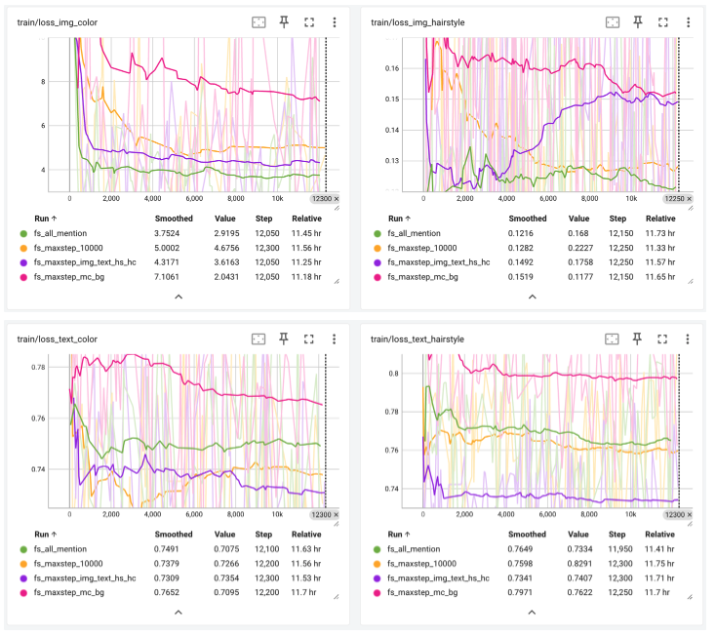
Fine tuning

Slide 36
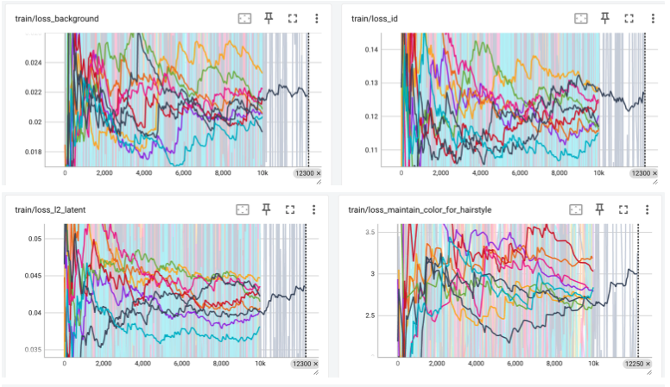
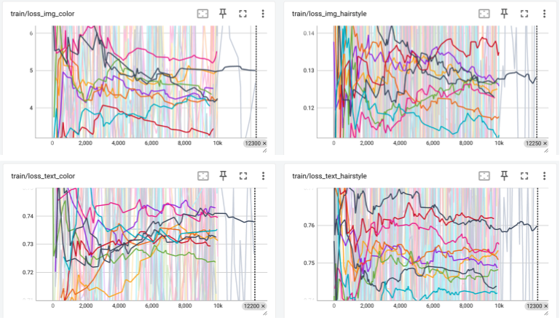
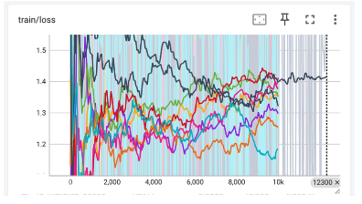
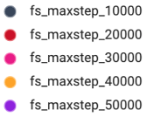
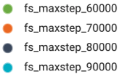
Fine tuning

Slide 37
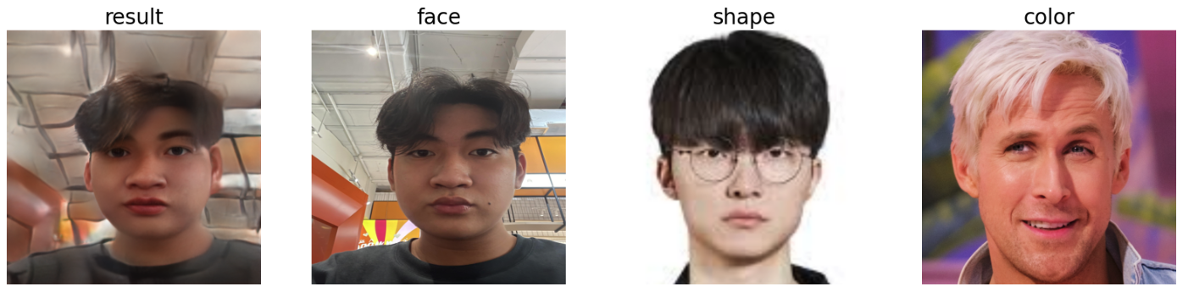
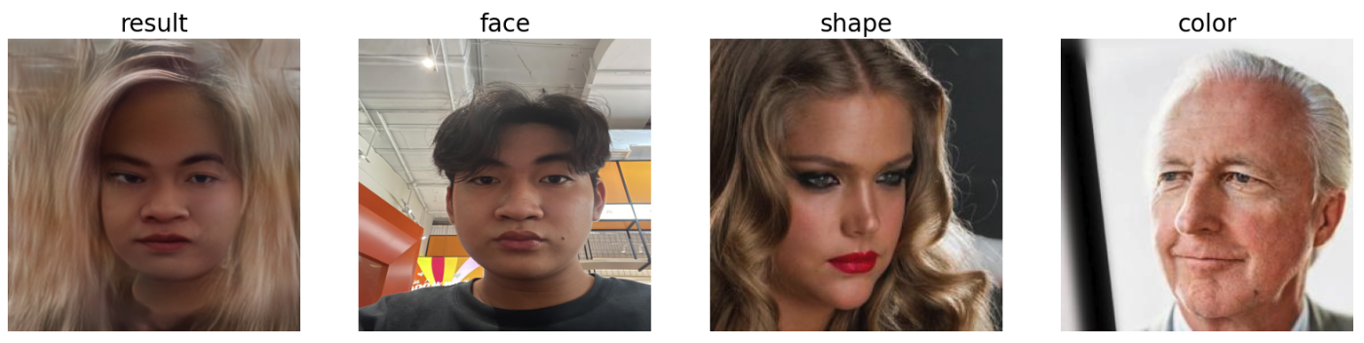
FS-demo

Slide 38
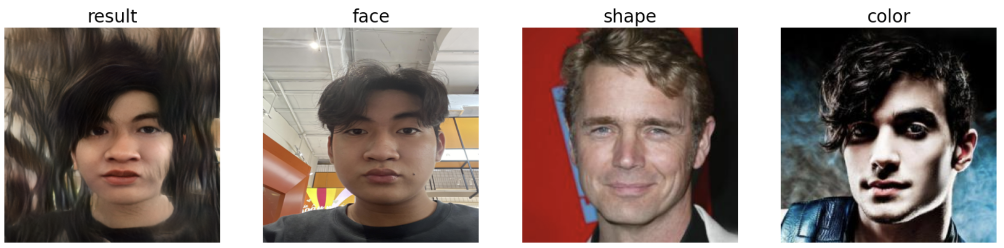
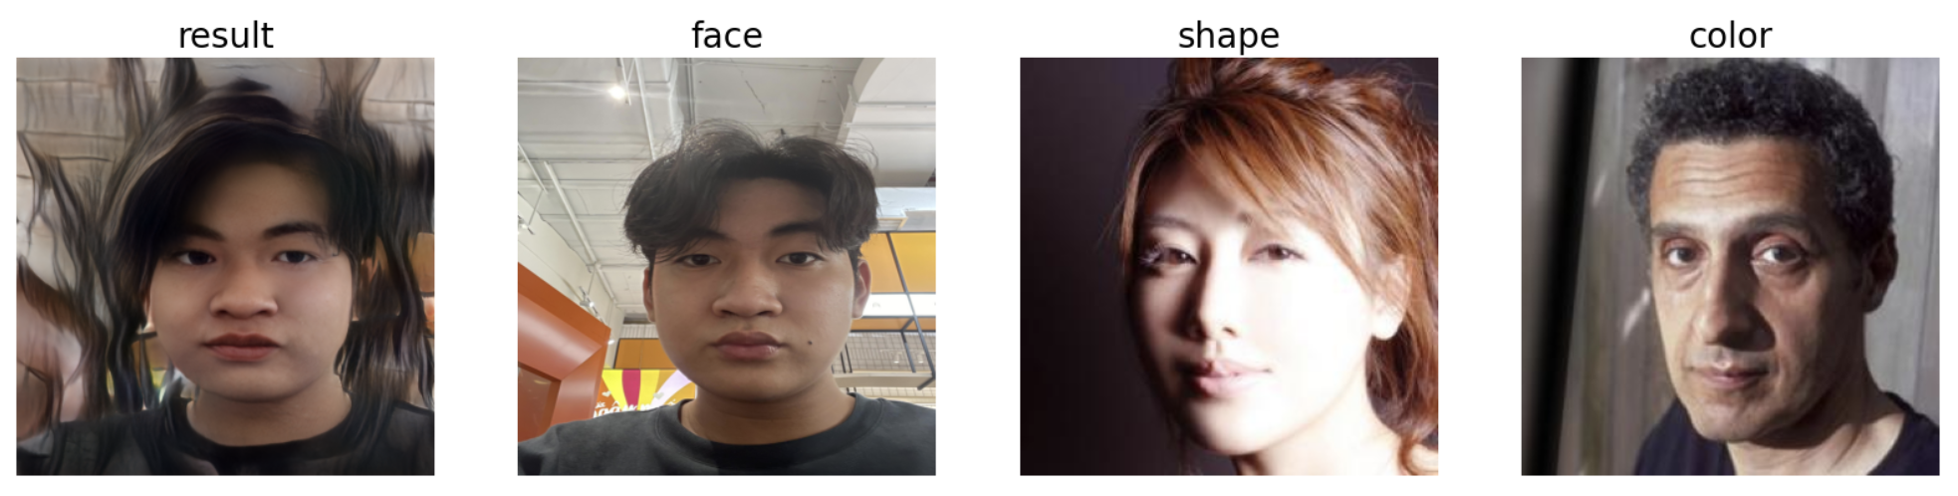
FS-demo

Slide 39
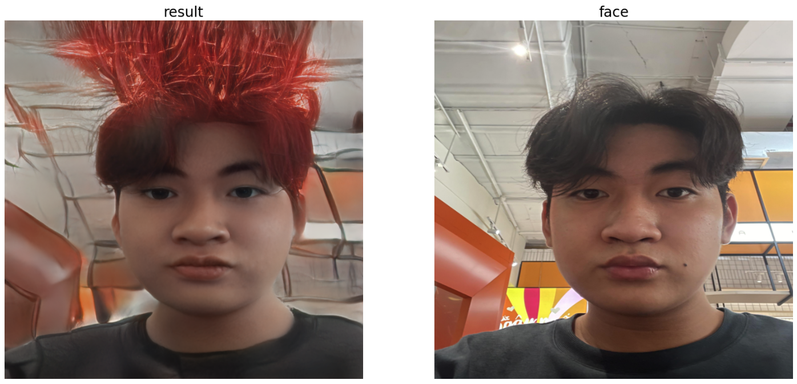
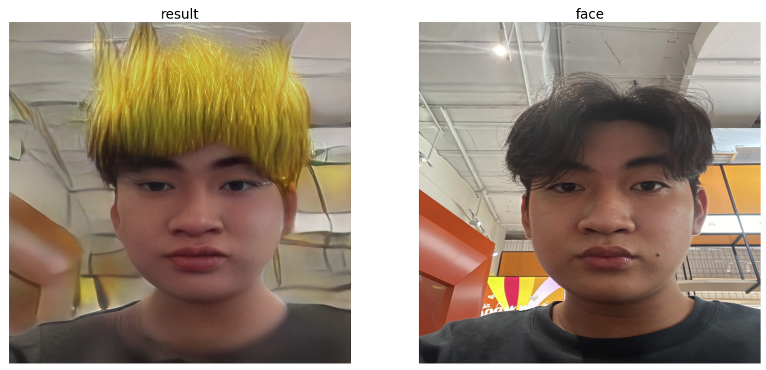
FS-demo
curtained hair hairstyle
red
shingle bob hairstyle
yellow

Slide 40
05
Further Experiment

Slide 41
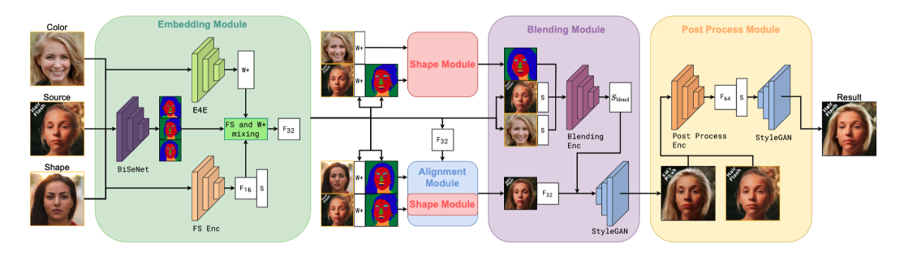
HairFastGAN

Slide 42
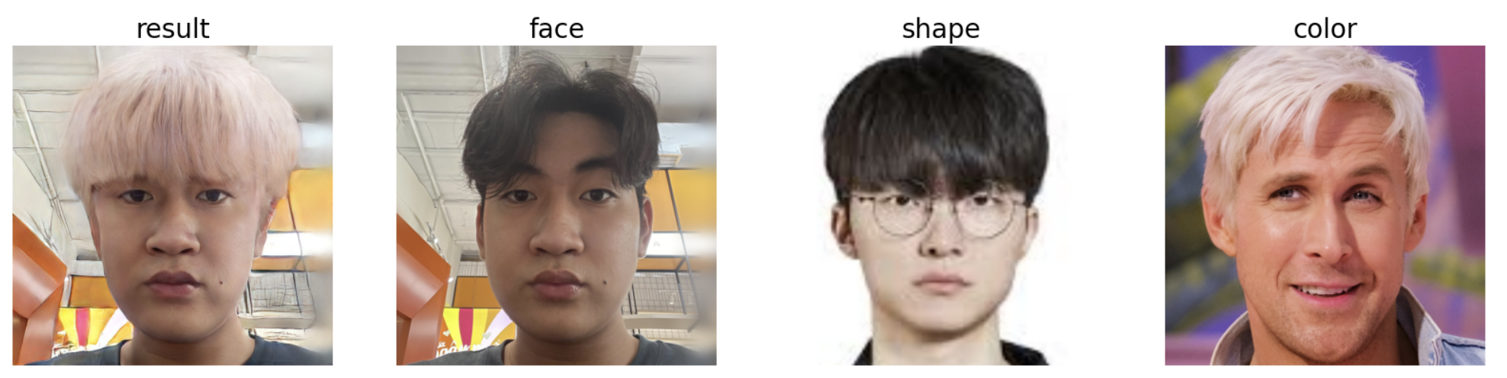
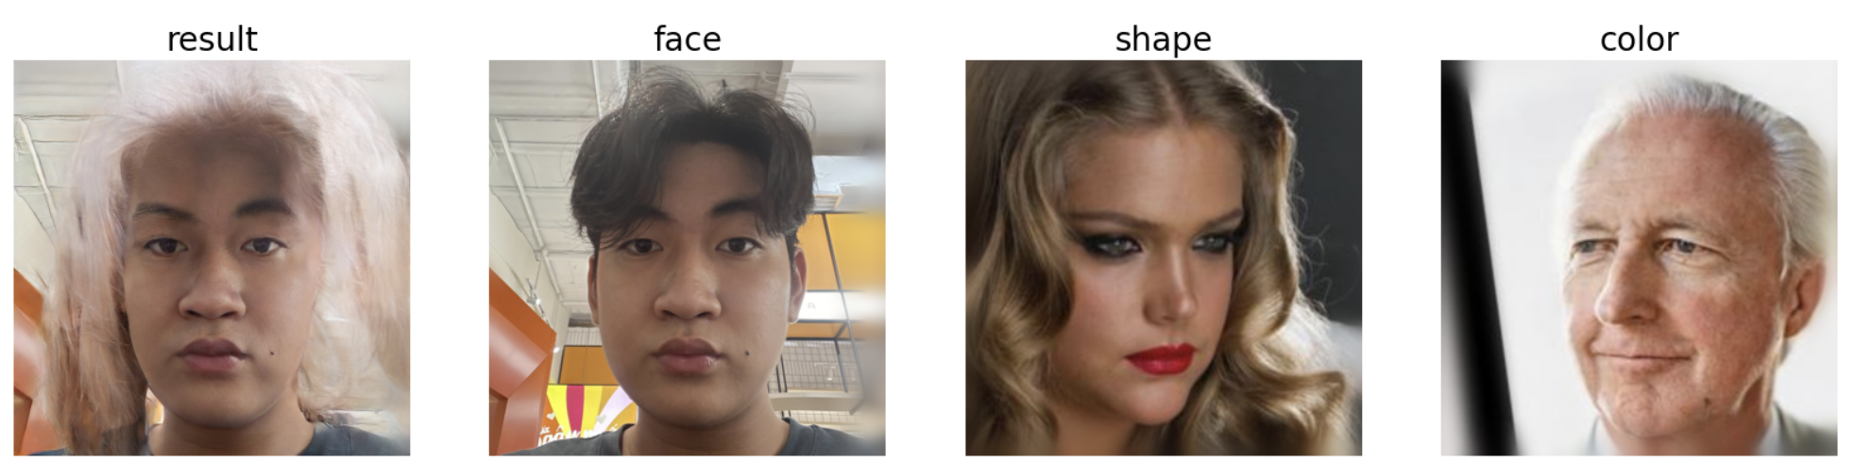
HairFastGAN-Demo

Slide 43
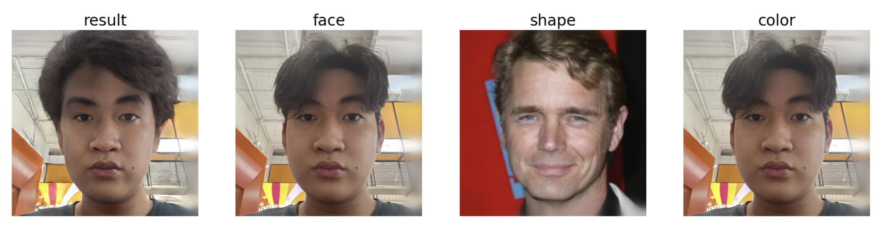
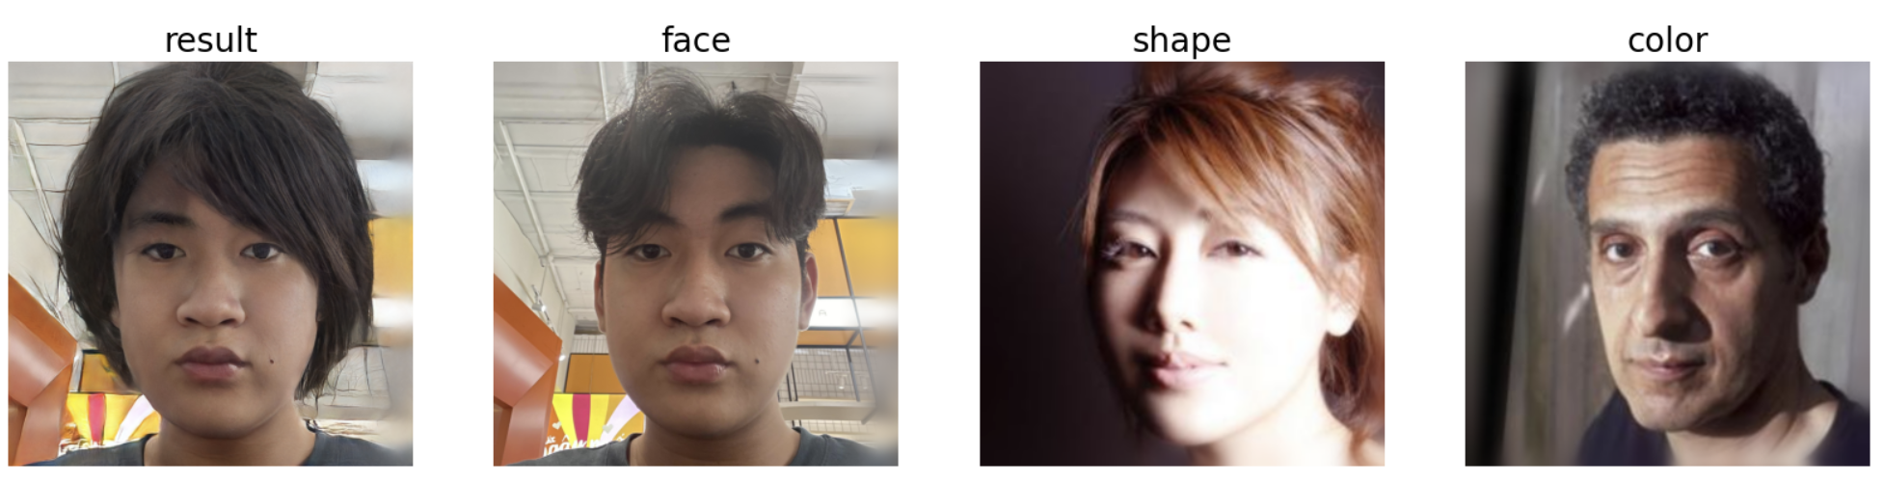
HairFastGAN-Demo

Slide 44
06
Evaluation

Slide 45
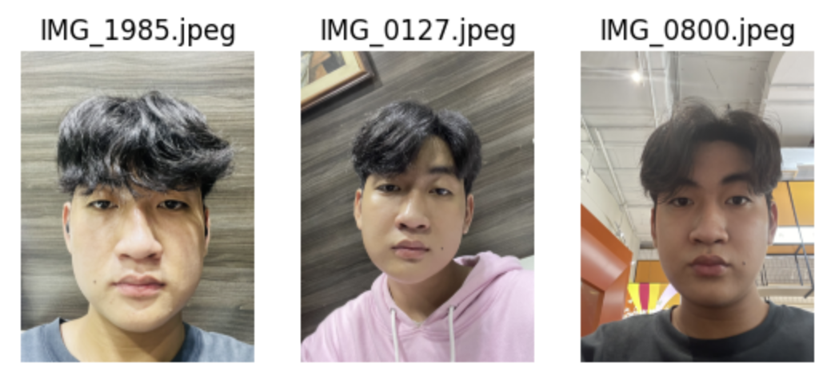
Dataset

Slide 46


Dataset

Slide 47

FID

Slide 48

Arcface Loss

Slide 49
Reference
HairClip:
https://openaccess.thecvf.com/content/CVPR2022/papers/Wei_HairCLIP_Design_Your_Hair_by_Text_and_Reference_Image_CVPR_2022_paper.pdf
HairFastGan:
https://arxiv.org/pdf/2404.01094
FS Encoder
https://arxiv.org/pdf/2202.02183
E4e Encoder
https://arxiv.org/pdf/2102.02766

